Slide 1

NATIONAL UNIVERSITY OF MODERN LANGUAGES
Faculty of Engineering and Computing
Department of Software Engineering

Slide 2
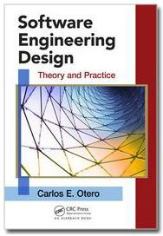
SOFTWARE DESIGN AND ARCHITECTURE
LECTURE NO. 9
Introduction to Software Engineering Design
Course Instructor: | Mr. Ahsan Arif
 | Lecturer Department of Software Engineering NUML Islamabad
Date: December 18, 2024
Software Engineering Design: Theory and Practice

Slide 3
LECTURE CONTENTS
  Human-Computer Interface Design
    What Is Human–Computer Interface Design?
    Why Study Human–Computer Interface Design?
    General HCI Design Principles
Date: December 18, 2024
Software Engineering Design: Theory and Practice

Slide 4
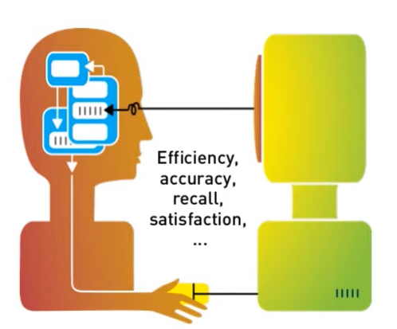
HUMAN-COMPUTER INTERFACE DESIGN
What Is Human–Computer Interface Design?
Human-Computer Interface Design, also known as Human-Computer Interaction (HCI) design, is the process of creating interfaces that allow efficient and intuitive interaction between humans and computers.
Date: December 18, 2024
Software Engineering Design: Theory and Practice

Slide 5
HUMAN-COMPUTER INTERFACE DESIGN
Why Study Human–Computer Interface Design?
Importance of Human-Computer Interface (HCI) design:
System users often judge a system by its interface rather than its functionality.
  User interfaces should be designed to match the skills, experience and expectations of its anticipated users.
A poorly designed interface can cause a user to make catastrophic errors.
  A poor UI is often a reason why so many software systems are never used.
Date: December 18, 2024
Software Engineering Design: Theory and Practice

Slide 6
HUMAN-COMPUTER INTERFACE DESIGN
Revisit Usability Heuristics
Nielsen’s 10 principles
Norman’s rules from Design of Everyday Things
Tognazzini’s 16 principles
Shneiderman’s 8 golden rules
Same general ideas, organized differently
Date: December 18, 2024
Software Engineering Design: Theory and Practice
Notes:
To understand the technique, we should start by defining what we mean by a usability heuristic or guideline. Heuristics, or usability guidelines, are rules that distill out the principles of effective user interfaces. There are plenty of sets of guidelines to choose from - sometimes it seems like every usability researcher has their own set of heuristics. Most of these guidelines overlap in important ways, however. The experts don't disagree about what constitutes good UI. They just disagree about how to organize what we know into a small set of operational rules.
Heuristics can be used in two ways: during design, to help you choose among alternative designs; and during heuristic evaluation, to find and justify problems in interfaces.

Slide 7
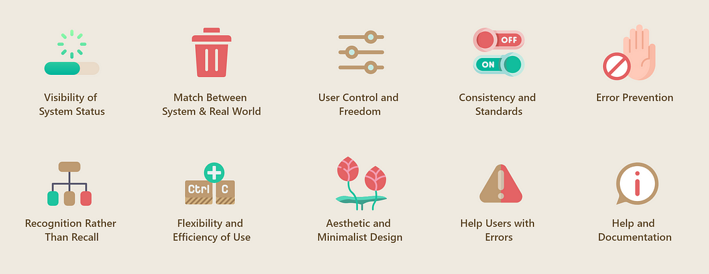
Nielsen’s 10 principles…
Date: December 18, 2024
Software Engineering Design: Theory and Practice
Notes:
The 10 heuristics defined by Jakob Nielsen and Rolf Molich are good practices that can be applied to interface design to evaluate its usability.
These are principles based on the observation of real users and the problems they face when using any type of interface.
They are generic guidelines which have been used for many years (the first version is from 1989 and the latest update from 2005) but, even so, they continue to be a valid instrument to detect usability problems today.

Slide 8
Nielsen’s 10 principles…
Match the real world (L)
Consistency & standards (L)
Help and documentation (L)
Learnability
User control and freedom (S)
Visibility of system status (S)
Efficiency
Flexibility and efficiency (E)
Error prevention (S)
Safety
Recognition, not recall (S)
Error reporting, diagnosis, and recovery (S)
Aesthetic and minimalist design
Date: December 18, 2024
Software Engineering Design: Theory and Practice

Slide 9
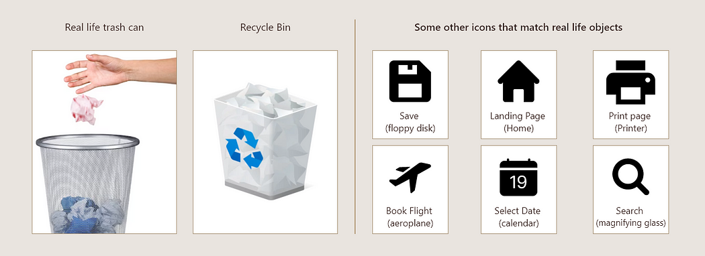
Match Between the System and the Real World (L)
Interfaces should communicate with users through concepts and phrases that are familiar to them. As such, designs should align with the users’ everyday language and experiences, avoiding internal jargon and unfamiliar terminology.
For example, navigation menus should use labels like “About Us” and “Blog” that people already know and understand.
Resemblance of real life objects in icons
Date: December 18, 2024
Software Engineering Design: Theory and Practice
Notes:
Jakob Nielsen, who invented the technique we're talking about, has 10 heuristics. (An older version of the same heuristics, with different names but similar content, can be found in his Usability Engineering book, one of the recommended books for designerss.)
We've talked about all of these in previous design principles reading (the particular reading is marked by a letter, e.g. L for Learnability).

Slide 10
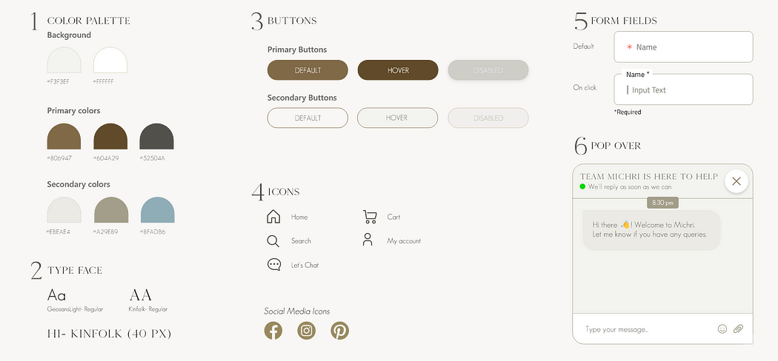
Consistency & standards (L)
Follow consistent conventions and design patterns throughout your interface, like using the same button styles and colors for similar actions.
Following a style guide is a good practice to maintain consistency
Date: December 18, 2024
Software Engineering Design: Theory and Practice
Notes:
Jakob Nielsen, who invented the technique we're talking about, has 10 heuristics. (An older version of the same heuristics, with different names but similar content, can be found in his Usability Engineering book, one of the recommended books for designerss.)
We've talked about all of these in previous design principles reading (the particular reading is marked by a letter, e.g. L for Learnability).

Slide 11
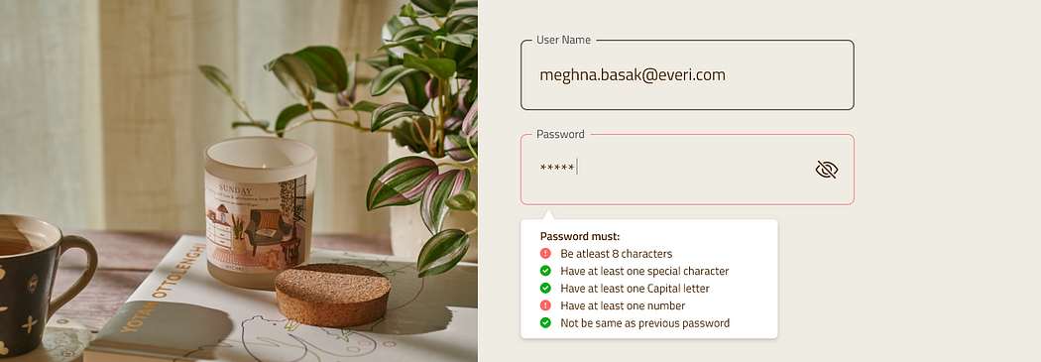
Help and documentation (L)
Ideally, systems should be designed to be as self-explanatory as possible. However, it’s often necessary to provide additional documentation to help users who require guidance or run into problems, especially with more complex software programs.
Effective tooltip design gives clarity and context to users
Date: December 18, 2024
Software Engineering Design: Theory and Practice
Notes:
Jakob Nielsen, who invented the technique we're talking about, has 10 heuristics. (An older version of the same heuristics, with different names but similar content, can be found in his Usability Engineering book, one of the recommended books for designerss.)
We've talked about all of these in previous design principles reading (the particular reading is marked by a letter, e.g. L for Learnability).

Slide 12
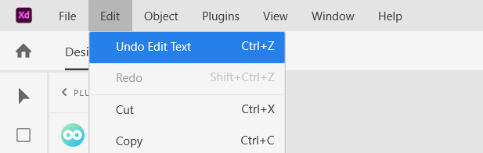
User control & freedom (S)
Allow users to easily navigate and exit situations, such as providing a “Cancel” or “Go Back” option during a multi-step process.
Undo and Redo gives flexibility to users
Date: December 18, 2024
Software Engineering Design: Theory and Practice
Notes:
Jakob Nielsen, who invented the technique we're talking about, has 10 heuristics. (An older version of the same heuristics, with different names but similar content, can be found in his Usability Engineering book, one of the recommended books for designerss.)
We've talked about all of these in previous design principles reading (the particular reading is marked by a letter, e.g. L for Learnability).

Slide 13
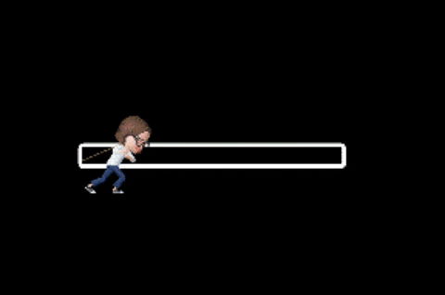
Visibility of system status (S)
Keep users informed about what’s happening through appropriate feedback within a reasonable time. For example, show loading indicators during data processing.
Progress bar indicating status
Date: December 18, 2024
Software Engineering Design: Theory and Practice
Notes:
Jakob Nielsen, who invented the technique we're talking about, has 10 heuristics. (An older version of the same heuristics, with different names but similar content, can be found in his Usability Engineering book, one of the recommended books for designerss.)
We've talked about all of these in previous design principles reading (the particular reading is marked by a letter, e.g. L for Learnability).

Slide 14
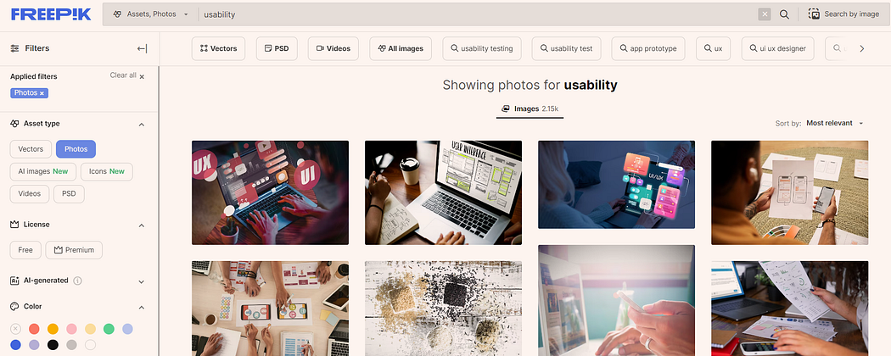
Flexibility and efficiency (E)
Cater to both novice and expert users. Offer shortcuts and advanced features for experienced users while keeping basic functions simple for beginners.
New users can search for images, expert users can use filters for favorable results
Date: December 18, 2024
Software Engineering Design: Theory and Practice
Notes:
Jakob Nielsen, who invented the technique we're talking about, has 10 heuristics. (An older version of the same heuristics, with different names but similar content, can be found in his Usability Engineering book, one of the recommended books for designerss.)
We've talked about all of these in previous design principles reading (the particular reading is marked by a letter, e.g. L for Learnability).

Slide 15
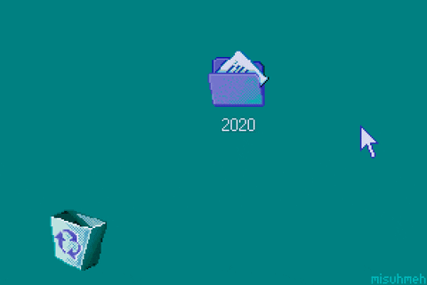
Error prevention (S)
Implement safeguards to prevent errors, such as confirmation dialogs before critical actions like deleting data.
Confirmation messages can prevent unwanted mistakes by user
Date: December 18, 2024
Software Engineering Design: Theory and Practice
Notes:
Jakob Nielsen, who invented the technique we're talking about, has 10 heuristics. (An older version of the same heuristics, with different names but similar content, can be found in his Usability Engineering book, one of the recommended books for designerss.)
We've talked about all of these in previous design principles reading (the particular reading is marked by a letter, e.g. L for Learnability).

Slide 16
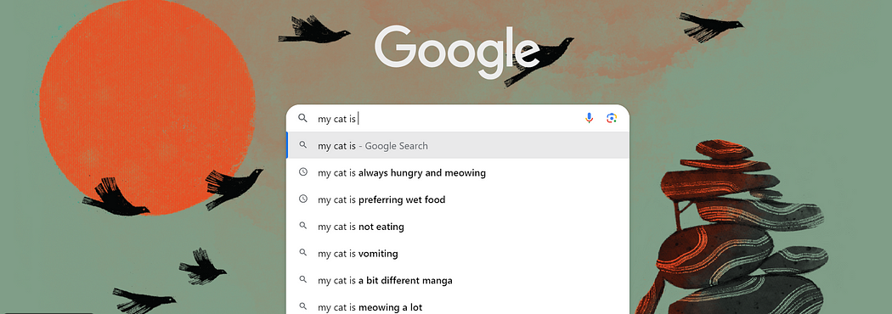
Recognition, not recall (S)
Make information, options, and actions visible and easily accessible. Avoid relying on users’ memory, and provide labels and cues where needed.
Google Suggest is designed to help users find relevant search queries more quickly
Date: December 18, 2024
Software Engineering Design: Theory and Practice
Notes:
Jakob Nielsen, who invented the technique we're talking about, has 10 heuristics. (An older version of the same heuristics, with different names but similar content, can be found in his Usability Engineering book, one of the recommended books for designerss.)
We've talked about all of these in previous design principles reading (the particular reading is marked by a letter, e.g. L for Learnability).

Slide 17
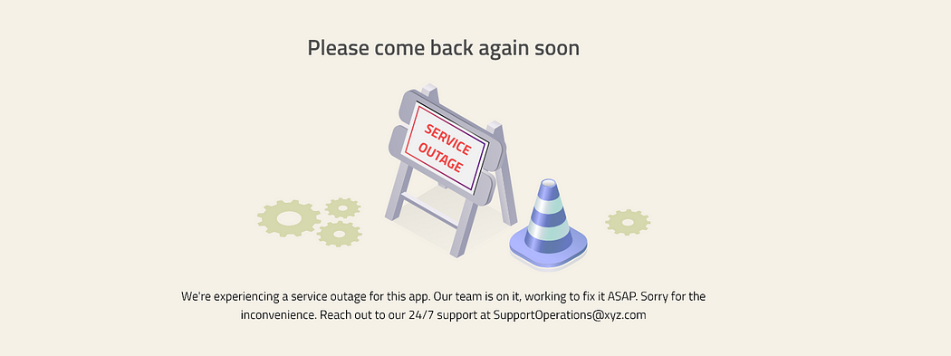
Error reporting, diagnosis, and recovery (S)
Clearly communicate error messages, their causes, and provide guidance on how to recover from them.
Explanative error messages can improve user retention
Date: December 18, 2024
Software Engineering Design: Theory and Practice
Notes:
Jakob Nielsen, who invented the technique we're talking about, has 10 heuristics. (An older version of the same heuristics, with different names but similar content, can be found in his Usability Engineering book, one of the recommended books for designerss.)
We've talked about all of these in previous design principles reading (the particular reading is marked by a letter, e.g. L for Learnability).

Slide 18
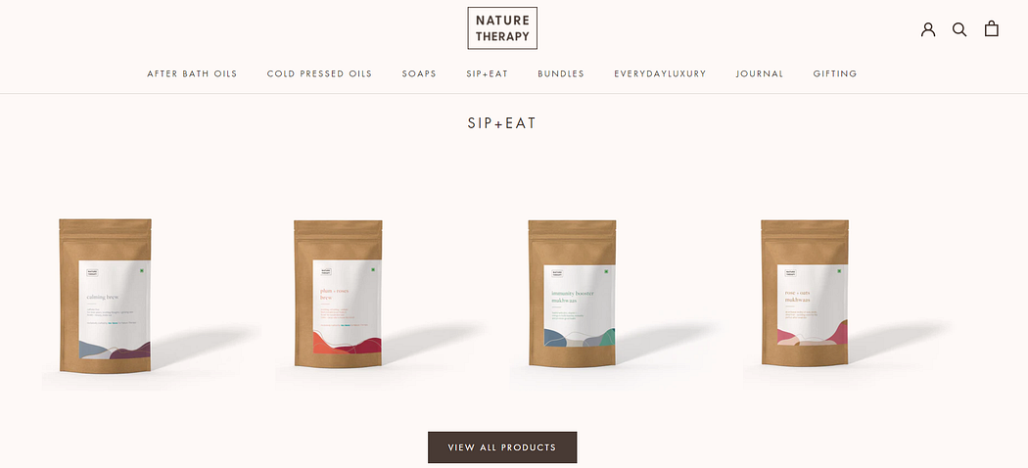
Aesthetic and minimalist design
Focuses on reducing unnecessary elements, simplifying the layout, and enhancing the visual harmony of interface.
https://www.naturetherapy.co.in/ has a clean display of products that look appealing
Date: December 18, 2024
Software Engineering Design: Theory and Practice
Notes:
Jakob Nielsen, who invented the technique we're talking about, has 10 heuristics. (An older version of the same heuristics, with different names but similar content, can be found in his Usability Engineering book, one of the recommended books for designerss.)
We've talked about all of these in previous design principles reading (the particular reading is marked by a letter, e.g. L for Learnability).

Slide 19
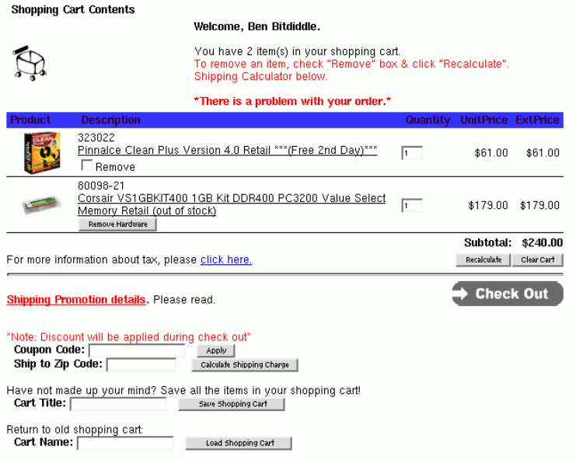
Example…
Nielsen Heuristics
Match the real world (L)
Consistency & standards (L)
Help & documentation (L)
User control & freedom (S)
Visibility of system status (S)
Flexibility & efficiency (E)
Error prevention (S)
Recognition, not recall (S)
Error reporting, diagnosis, and recovery (S)
Aesthetic & minimalist design
Date: December 18, 2024
Software Engineering Design: Theory and Practice
Notes:
Jakob Nielsen, who invented the technique we're talking about, has 10 heuristics. (An older version of the same heuristics, with different names but similar content, can be found in his Usability Engineering book, one of the recommended books for designerss.)
We've talked about all of these in previous design principles reading (the particular reading is marked by a letter, e.g. L for Learnability).

Slide 20
Solution…
Here are two of the heuristics mentioned in the image that could be relevant to the error message:
Match the real world: This heuristic suggests that interfaces should use terms and concepts that are familiar to users in their everyday world.
  For example, an error message could say “We couldn’t find an item in your cart” instead of “There is a problem with your order.”
Visibility of system status: This heuristic suggests that interfaces should keep users informed about what is happening at all times.
  For example, an error message could be more specific about what the problem is and how to fix it.
By following these heuristics, designers can create interfaces that are more helpful and less likely to cause errors.
Date: December 18, 2024
Software Engineering Design: Theory and Practice
Notes:
Jakob Nielsen, who invented the technique we're talking about, has 10 heuristics. (An older version of the same heuristics, with different names but similar content, can be found in his Usability Engineering book, one of the recommended books for designerss.)
We've talked about all of these in previous design principles reading (the particular reading is marked by a letter, e.g. L for Learnability).

Slide 21
References
https://thedecisionlab.com/reference-guide/design/nielsens-heuristics
https://designftw.mit.edu/lectures/heuristic-eval/#error-prevention
https://www.youtube.com/watch?v=MdgBdrcMLQg
Date: December 18, 2024
Software Engineering Design: Theory and Practice

Slide 22
Thank You...
Mr. Ahsan Arif
Lecturer (Dept. of Software Engineering)
ahsanarif.se42@gmail.com

